Slide 1

Dissertation Proposal —Context-aware services？
Student: Guangxi Lu
Committee:
...

Slide 2
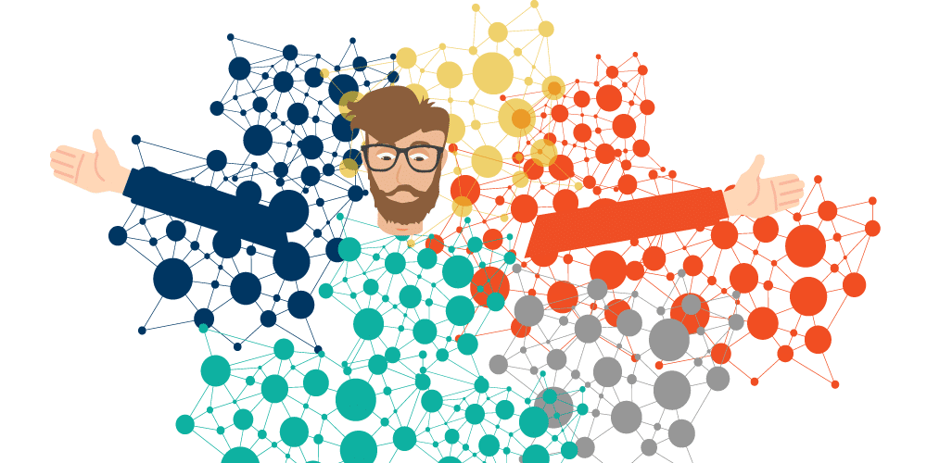



Graph in our life:
Social Network
Navigation
Knowledge graph
Electronic commerce
Notes:
SN:We use the sites like Facebook, Twitter, and Instagram to connect with our friends and family, and even make new connections to the strengers.
KG:when we use the internet to search for information, for example google, we often get quick answers right at the top of our search results
NA:we use maps or GPS to get directions, we're using navigation graphs. These graphs help us find our way around new places and can even give us best routes to avoid Traffic jams or construction.
E-COM:These graphs help us make informed buying decisions and have a better shopping experience.

Slide 3
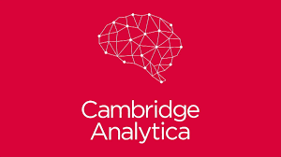

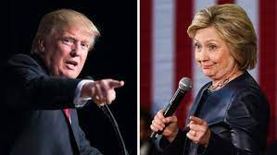



Why privacy is important on graph data?
87 million User Profile
5 billion in penalties
Notes:
Cambridge Analytica case in 2018.
The Cambridge Analytica is a political consulting company.
they use data from millions of Facebook users without their permission to construct the personal profiles . In total, there are 87 million Facebook users' personal information was leakage to Cambridge Analytica.
This events has created a deep fear that who control the social networks will alsocontrol the opinion of the whole society.
the bad news for facebook is the event made U.S. Federal Trade Commission imposed a 5 billion penalties to facebook

Slide 4
Privacy in Graph structure data
Privacy in graph
Privacy in graph model
Privacy in graph data
Graph to protect privacy
Graph Convolutional Networks
Graph De-anonymization
Centralized or Decentralized
Notes:
The first aspect I'd like to primarily introduce the attacks and defenses on graph convolutional networks.
The second i am forcus on use GCN to do the Graph De-anonymization .
And the third aspect mainly aims to compare privacy preservation in centralized and decentralized model training.

Slide 5
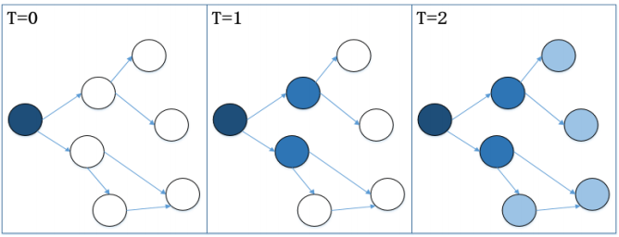

Privacy in the graph model
Target model: Graph convolutional network
Lack of Robustness
(1)
Notes:
The main idea of GCN is to capture the global information of a graph by downscalingg the high-dimensional neighborhood information into a low-dimensional vector representation.
One of the main security issue of GCNs is their lack of robustness
it means attackers can control the results predicted by GCN models to present false or misleading information to users.
And it is vital to address these security issues to ensure the integrity and reliability of GCN models and the data they process.

Slide 6
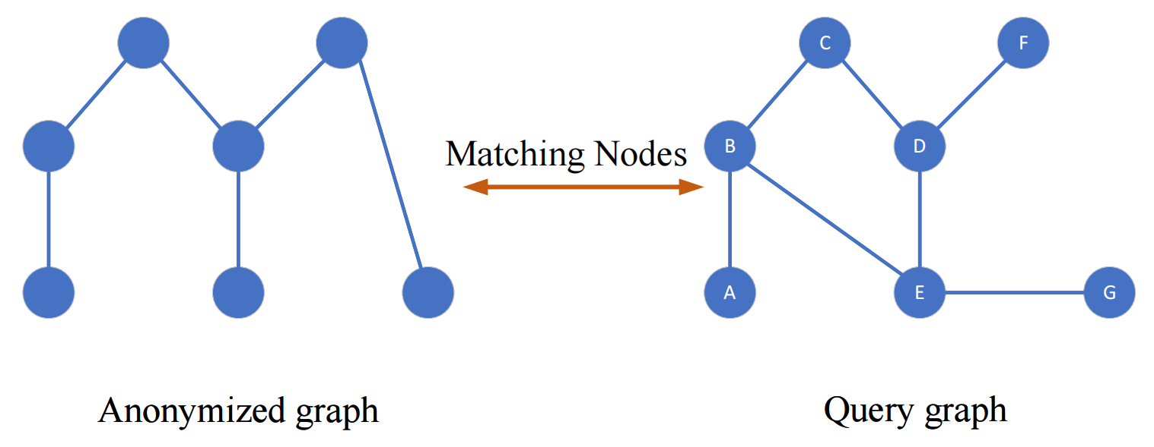
Privacy in graph data
Graph mining：Graph de-anonymization
Notes:
A real-world example of graph de-anonymization can be seen in the Netflix.
So here is a Prize competition where the Netflix released an anonymized dataset of movie ratings made by its users to encourage researchers to improve the accuracy of its movie recommendation system.

Slide 7
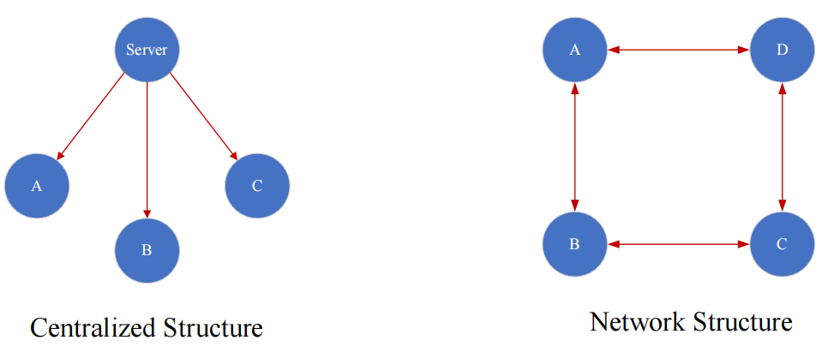
Graph to protect privacy
Decentralized design
Decentralize the authority and guarantee the fairness.
Notes:
the main idea here is how to use the network structure to protect the training process of the model.

Slide 8
Pairwise Gaussian Graph Convolutional Networks:
Defense Against Graph Adversarial Attack
Guangxi Lu, Zuobin Xiong, Jing Meng, Wei Li
The 2022 IEEE Global Communications Conference

Slide 9
Roadmap
Challenge
Contribution
Attack Model
Defense Model
Experimental Results

Slide 10
Challenge
Robustness：GCN is a messaging-passing framework. Therefore, a perturbation of one node affects his neighboring nodes, thus affecting all nodes in the graph during the messaging-passing process.
Fidelity：It is difficult to minimize the impact of perturbations under adversarial attacks while ensuring the classification accuracy
Notes:
One challenge is the instability caused by changes in graph structure or graph node.
The other challenge here is hard to balanc the robustness and the fidelity.

Slide 11
Contribution
The first to propose the idea of pairwise structure to design GCN models for the defense against graph adversarial attack.
Graph features are shared between the Gaussian GCN and the Anti-perturbed GCN to estimate classification loss and differential loss
The results of real-data experiments validates the advantages of our PGGCN framework in model robustness and classification accuracy.

Slide 12
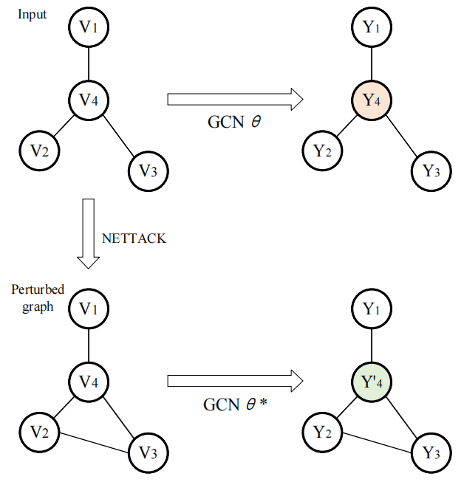

Attack Model
GCN lacks robustness and is vulnerable to graph adversarial attacks.
Graph adversarial attacks mislead GCN results by making imperceptible modifications to graph data.
The idea of Graph adversarial attack is to maximize the GCN classification loss.
Nettack:
(1)

Slide 13
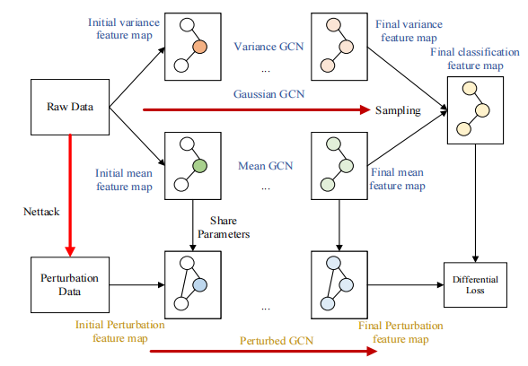
Defense Model
Improving model robustness while ensuring model accuracy.
PGGCN is a pairwise structure consisting of a Gaussian GCN and a Perturbed GCN.
Gaussian GCN improves model robustness by using Gaussian distributions instead of node features.
Perturbed GCN ensuring model accuracy by minimizing features.

Slide 14
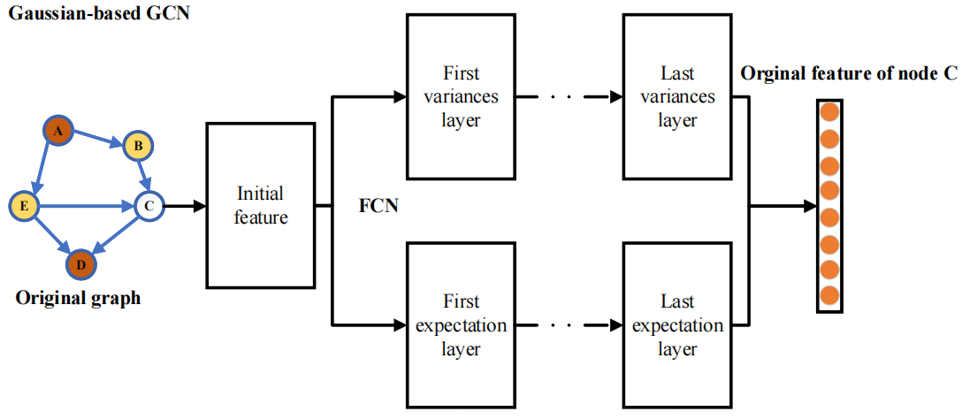
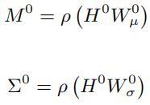
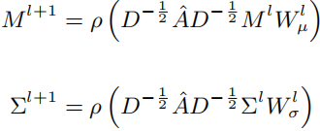

FCN：
GaussianGCN：
Sampling：
Improving Robustness by Introducing Gaussian Distribution.
Implementing Gaussian distribution by back propagation.

Slide 15
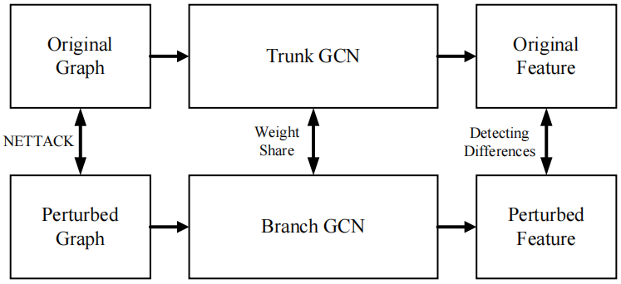


（1）
Differential loss improves the robustness model.
Classification loss ensures the classification accuracy.
（2）
（3）

Slide 16
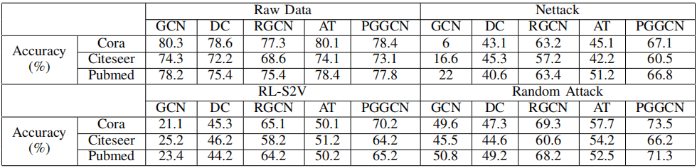
Experimental Results
Prediction accuracy of all models

Slide 17
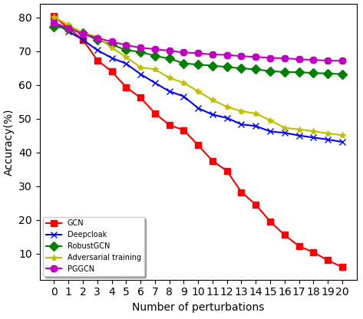
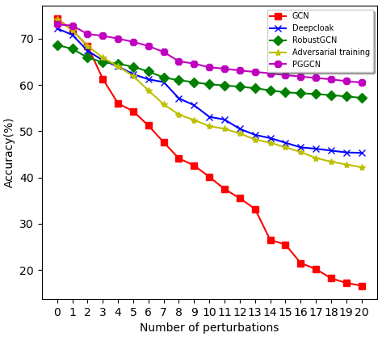
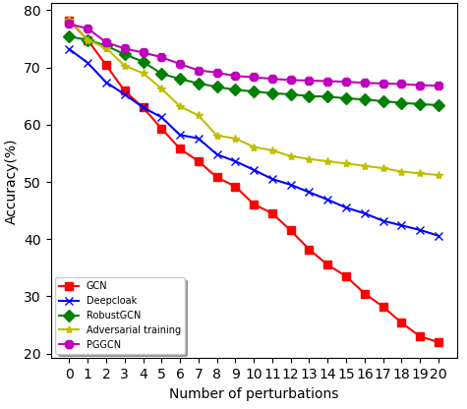
Nettak attack on Cora dataset
Nettak attack on Citeseer dataset
Nettak attack on Pubmed dataset
Notes:
x-axis represents the number of perturbations and defines by the bardget for which the attack is not detected and y-axis is the accrucy.

Slide 18
Graph Neural De-anonymization
Guangxi Lu, Kaiyang Li
manuscript

Slide 19
Roadmap
Introduction
Challenge
Algorithm Design
Experimental Results

Slide 20
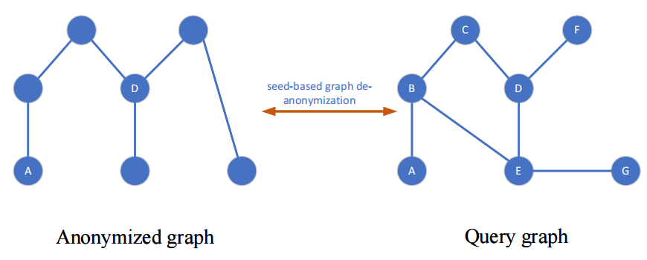
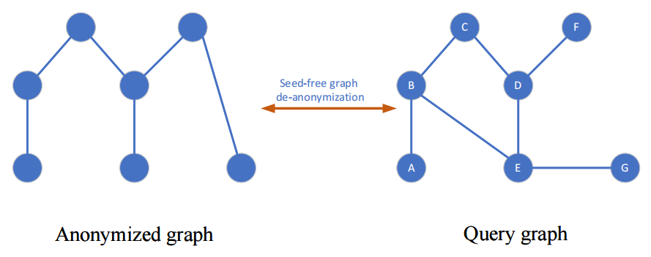
Seed-based
VS
Seed-free
Notes:
for graph de-anonymisation , there are two different graph de-anonymization problem Depending on the input provided and the information used.
The first method requires pairs of matching node with known identity information as seed information, which we call seed-based graph de-anonymization.
The second method does not require seed information so it is called seed-free graph de-anonymization.
This type of method tends to match by structural feature information of nodes for example the node degree, the subgraph, node similarity, and side informations.

Slide 21
Challenge
For seed-free graph de-anonymization:
Complexity: Difficult to handle a large graph data.
High dimensionality: Social network graphs often have high dimensionality.
Conflicting information: Hard to determine the correct de-anonymization results.
High dimensional graph to Low dimensinal vector
Notes:
Complexity, Traditional graph de-anonymization techniques face difficulties with handling big data, and the algorithms may require advanced hardware to handle the scale.
High dimensionality problem. the graphs like Social network often have high dimensional, and making it challenging to extract meaningful information and relationships between one individuals.
Conflicting information, the information between different sources can make it challenging to determine the correct de-anonymization results.

Slide 22
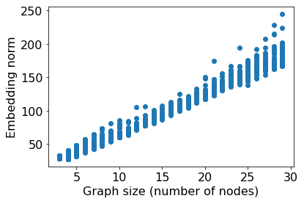
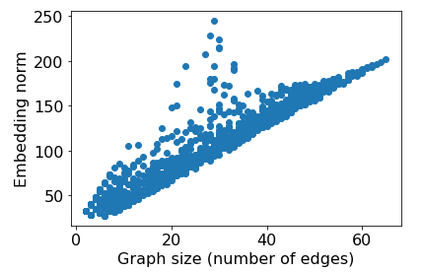
Motivation:
We see that the embedding norm for each graph size scales roughly with size：
Notes:
we could express the structural information of the graph in terms of mbedding vector.
for example, we find that as the size of the graph increases, the value of the corresponding vector increases in a positive correlation.
When the number of nodes and edges of a graph increases, its embedding norm also increases .

Slide 23
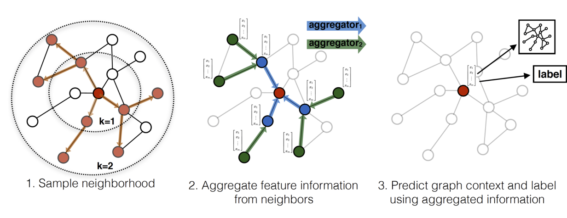
Algorithm Design
Embedding phase: For every node u. We Extract the k-hop neighborhood and then maps node into an embedding vetor Z_{u}
GraphSAGE^{[1]}:
[1] Hamilton, Will, Zhitao Ying, and Jure Leskovec. "Inductive representation learning on large graphs." Advances in neural information processing systems 30 (2017).
Notes:
the goal is to obtain embedding information for each node, which should have the information about the graph structure adjacent to that node.
Thereforem ,we first obtain a k-hop subgraph based
BFS

Slide 24






Algorithm Design
Comparison phase: Only nodes with consistent structure and features can be matched.
Structural distance:
$$(1)$$
Feature distance:
$$(2)$$
$$(3)$$
Notes:
Our matching principle is that a match is considered reasonable if both the structure and node features are kept consistent.

Slide 25
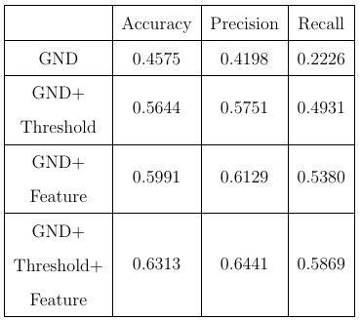
Experimental Results
Experiment in LastFM Asian social network
Notes:
For our experiments, we used the LastFM Asian social network dataset from Stanford University. The nodes, representing LastFM users from Asian countries, and they are linked by mutual following relationships. The side information or node features were obtained based on users favorite artists.

Slide 26
Decentralized Federated Learning:
A defense against gradient inversion attack
Guangxi Lu, Zuobin Xiong, Ruinian Li, Wei Li
EAI WiCON 2022 - 15th EAI International Conference on Wireless Internet

Slide 27
Roadmap
Introduction
Attack model
Decentralized Design
Graph Design
Experimental Results

Slide 28
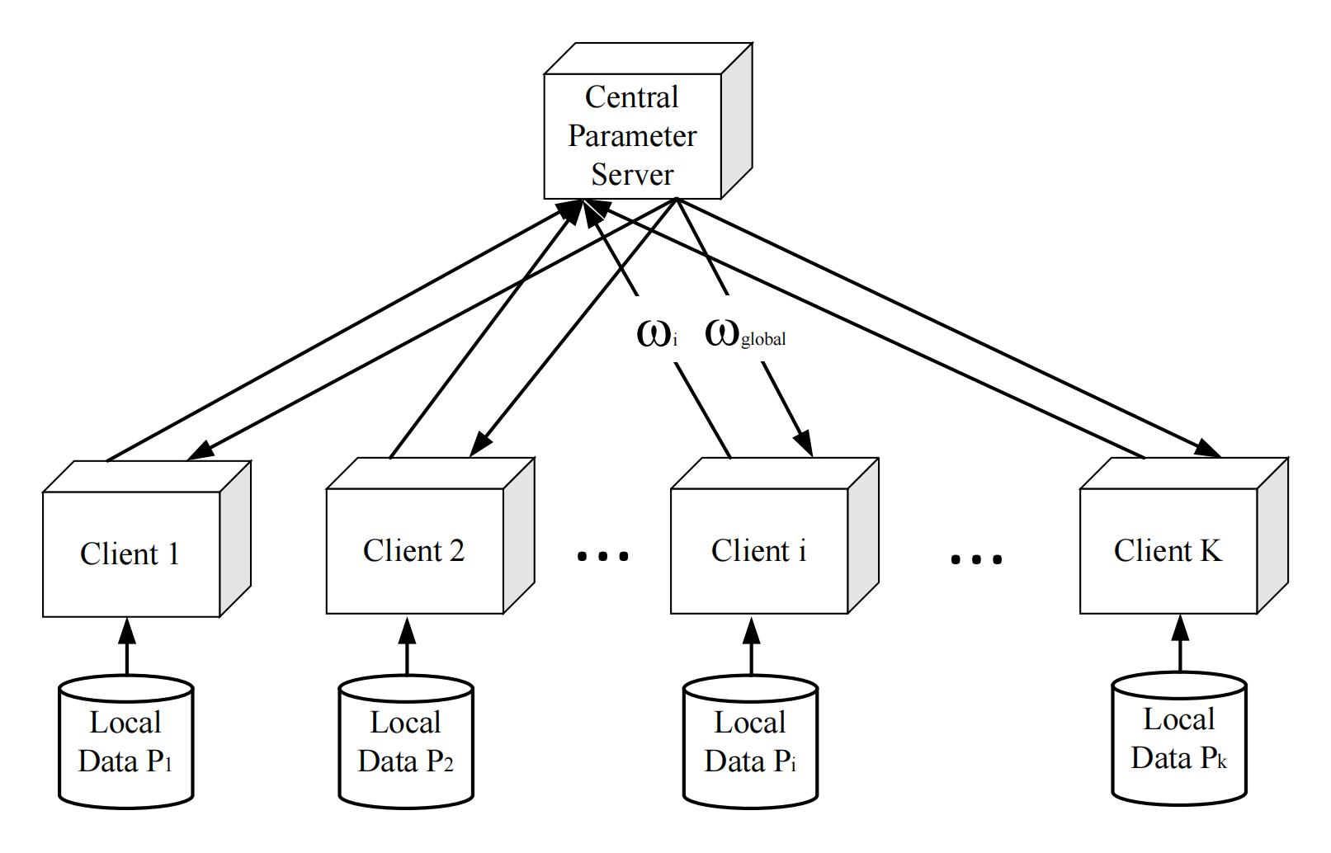
Introduction
What is federated learning?
Central server transmits the model to clients.
Clients train the model locally with own data.
Central server pools model results and generate global mode without accessing any data.
Notes:
The core idea of this problem is that even the local training is performed,
federal learning also requires to transfer the model parameters information.
But a central server has too much right that it has enough information to perform a gradient invension attack

Slide 29

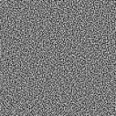





Attack Model
Gradient inversion attacks will recover training data by gradients.
Deep leakage from gradients[1]:
Model
F(x，W)
Victims：
Client
Pred
Loss
[0,0,1,0]
$$∇W$$
Input image x
Input label y
Model
F(x’，W)
$$∇W’$$
Attacker：
Server
Pred’
Loss’
Dummy image x’
$$D={\left\|∇W’−∇W\right\|}^{2}$$
Dummy label y’
$$∂D/∂x$$
$$∂D/∂y$$
[1]Zhu, Ligeng, Zhijian Liu, and Song Han. "Deep leakage from gradients." Advances in neural information processing systems 32 (2019).
Notes:
the Gradient Inversion Attack has been found to restore the training dataset through the training gradient.
DLG example

Slide 30
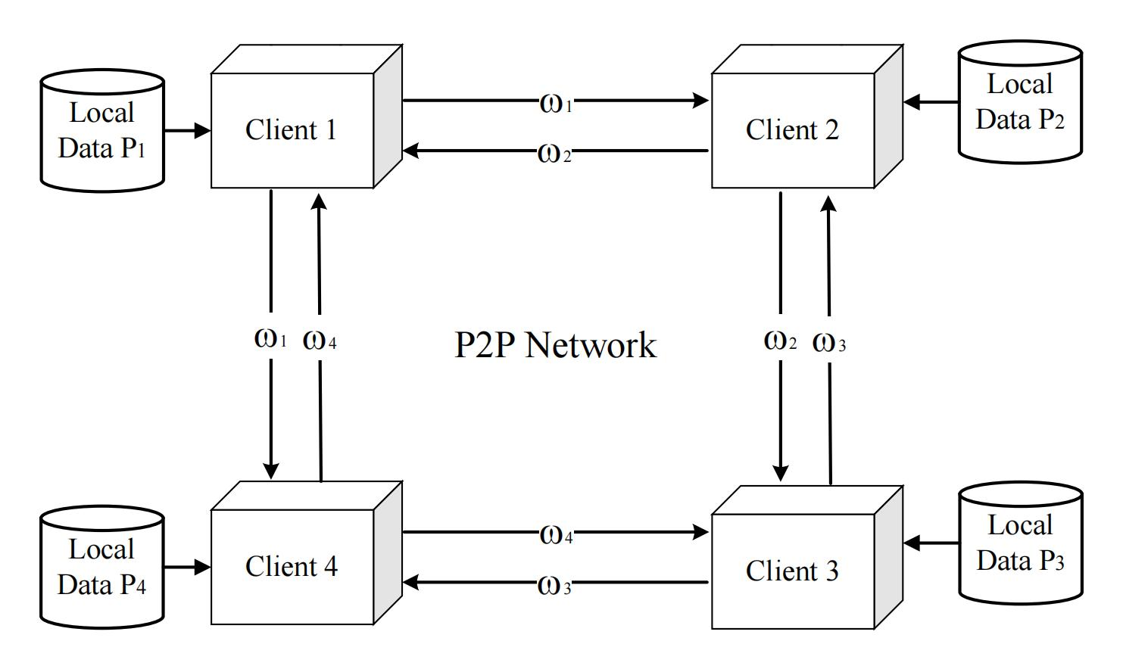
Decentralized Design
Decentralized Federated Learning(DFL)：
DFL removes the central server.
The client only communicates with its neighbors.
Use the peer to peer network to transfer the model.
Notes:
An intuitive way to defend against gradient attacks is to eliminate the central parameter server. Therefore, we use the decentralized struture
In our decentralized federation learning, each client only communicates with neighboring clients and transmits their model parameters.
All clients form a peer to peer network to train the model through this network, and basically it is a graph strcture.
In this framework, each client is trained only with their neighboring, so there is no theoretical global model.

Slide 31
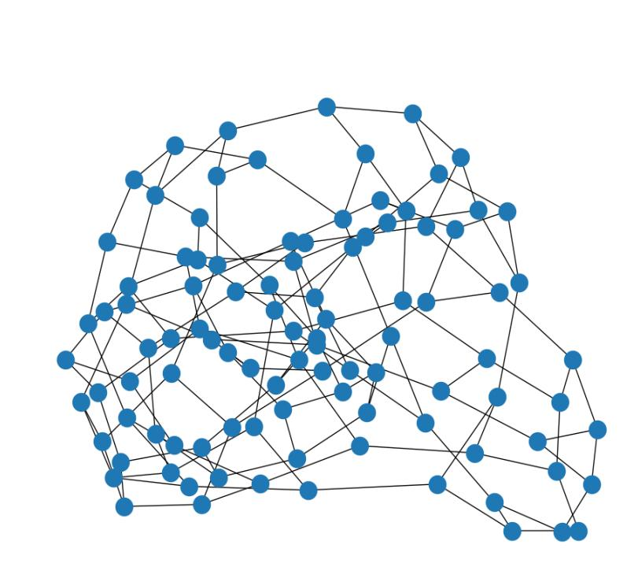
Server
W⁰
W⁰
Client 1
W⁰
W⁰
Client 4
Client 2
Client 3

Slide 32










Client Model $W_{1}^{t}$
Client Model $W_{4}^{t}$
$${W’}_{2}^{t+1}$$
$$W_{2}^{t+1}=\sum_{i=1}^{K}{\frac{n_{i}}{n}}{W’}_{i}^{t+1}$$
$${W’}_{1}^{t+1}$$
Client Model $W_{2}^{t}$
$${W’}_{2}^{t+1}$$
Client Model $W_{3}^{t}$
$${W’}_{3}^{t+1}$$
${W’}_{2}^{t+1}$=$W_{2}^{t}−η∇W_{2}^{t}$
Local
Data P₂

Slide 33
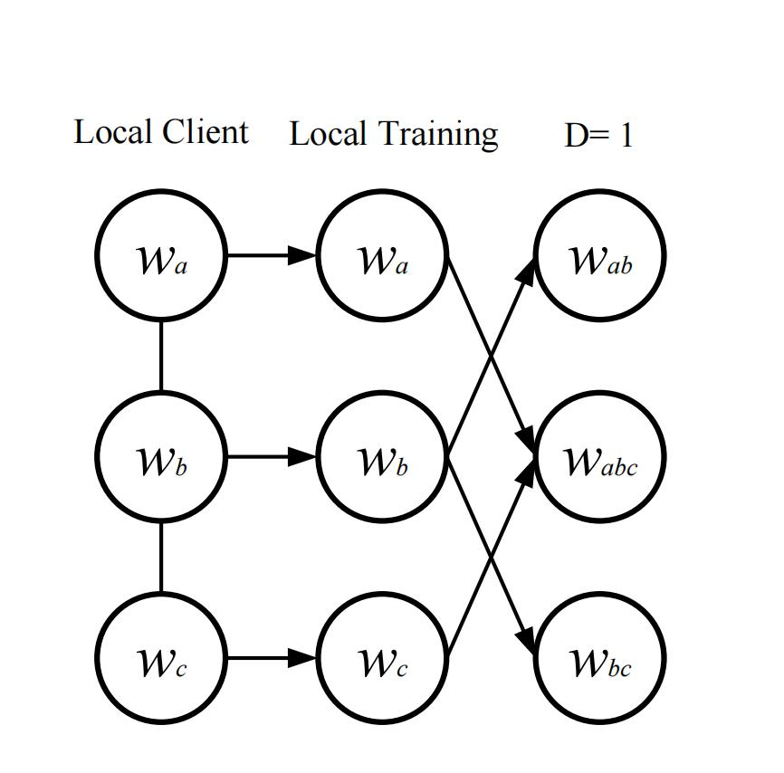
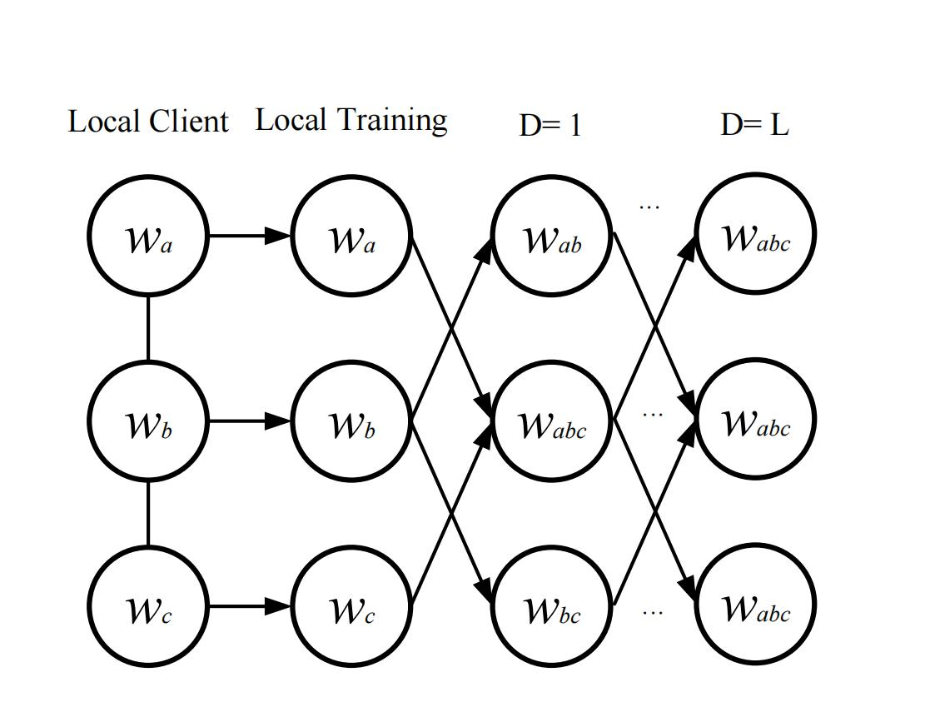
Training Design
DFL-I
DFL-G
Notes:
In the individual scheme (DFL-I)，The model performs only one parameter transfer for each local training session.
In this case, each client is only closely connected to the surrounding clients, and it is more difficult to obtain information from the farthest clients.
in the global scheme (DFL-G), The model performs multiple rounds of communication for each local training sessions.
The model can reach a global consensus through multiple communications.

Slide 34
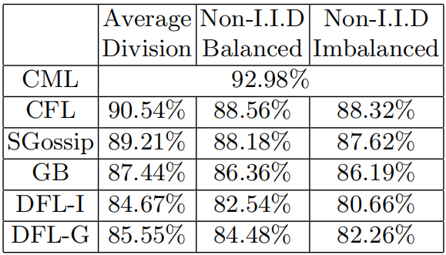
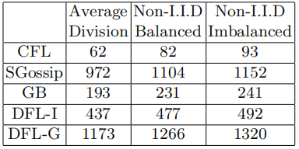
Experimental Results
Table 1. The accuracy of image classification
Table 2.Communication round of each framwork.
Notes:
We use the Fashion-MNIST dataset to measure the training accuracy of each framework on the model and the degree to which the model resists the gradient-invention attack.
Table 1 represents the accuracy of each framework for model training, where CML represents centralized machine learning, CFL is centralized federation learning.
SGossip and GB represent Gossi-based and global beliefs-based decentralized federation learning framework.
We divide the Fashion-MNIST dataset into three subset.
1,2,3…

Slide 35
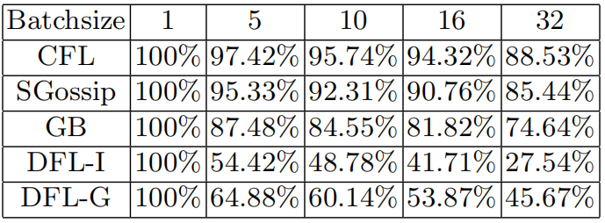
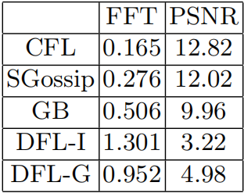
Table 3.The accuracy of label restoration
Table 4.The results of image restoration

Slide 36
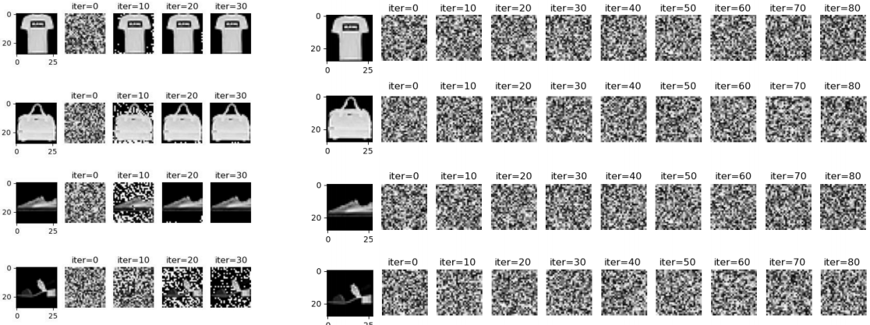
Fig 1.Attack retults on CFL
Fig 2.Attack retults on DFL
Notes:
Again we perform a case study of centralized federation learning and DFL, the attacker restores four images of the target t-shirt, bag, sneaker, and sandal.

Slide 37
Conclusion
Protected graph models enhance the security of graph data embedding.
Protected graph data further improves the privacy in distributed training.
Secure distributed training provides a secure method for training a graph models.
Graph Model
Graph Data
Privacy
Distributed Training
Notes:
The privacy protection of graphs can be divided into three main aspects, each of aspects make a crucial role to ensuring the security and privacy of graph.
graph model-based privacy protection focuses on preserving the robustness of graph embedding models to obtain accurate results.
graph data-based privacy protection involves ensuring the privacy of graph data itself.
using graph structure to protect the model involves use the structure of the graph to train more secure models.

Slide 38
Thank you!
Q&A

